Slide 1
Introduction to classical
deconvolution
NCBM Deep Learning workshop MBL 2019
Patrick La Riviere, Ph.D.
Associate Professor,
Radiology and Medical Physics
The University of Chicago

Slide 2
Overview

Slide 3

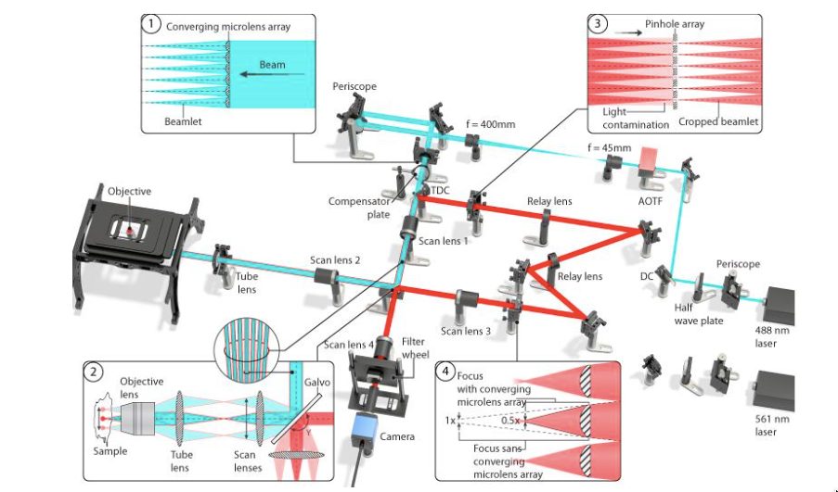
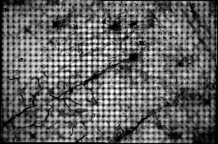
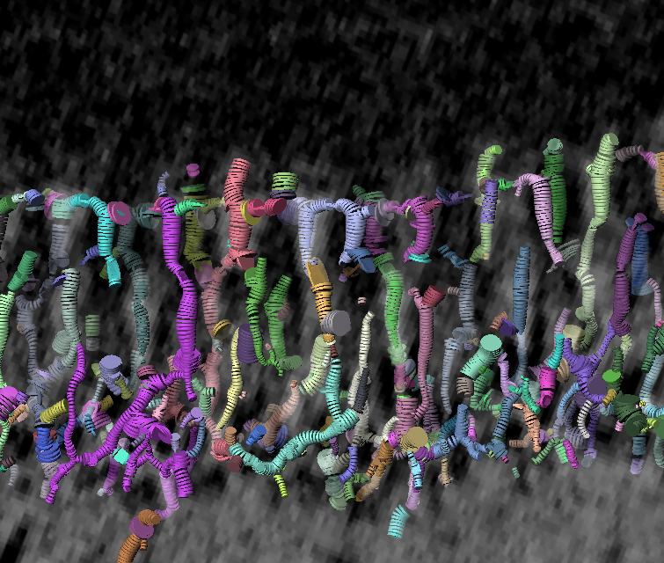
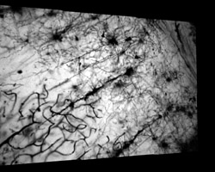

Imaging workflow
biological question
sample prep molecular & chemical probes
imaging hardware & methods development
computational imaging methods: tomography, deconvolution
image analysis: segmentation, particle tracking
?
biologists
biologists, chemists and physicists
physicists and engineers
computational scientists (inverse problems)
computational scientists (image processing)
Gladfelter, Waterman, Colon-Ramos, etc
Selvin, Tani
Shroff, Oldenbourg, Shribak
La Riviere
Danuser

Slide 4
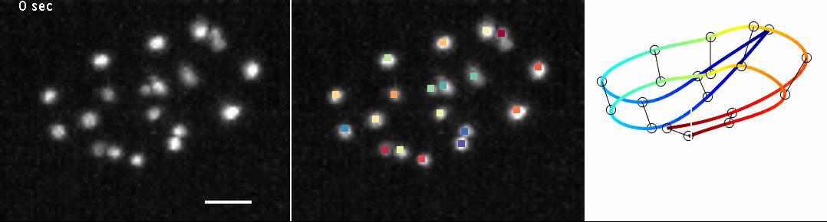
Computing on images
Nuclear segmentation and wireframe modeling of C. Elegans (Hari Shroff)
Results of connectivity analysis for retinal cells from synchrotron microCT. From Gordon Kindlmann (UChicago Computer Science).
Extracting information from images that is difficult or tedious for humans to do.

Slide 5
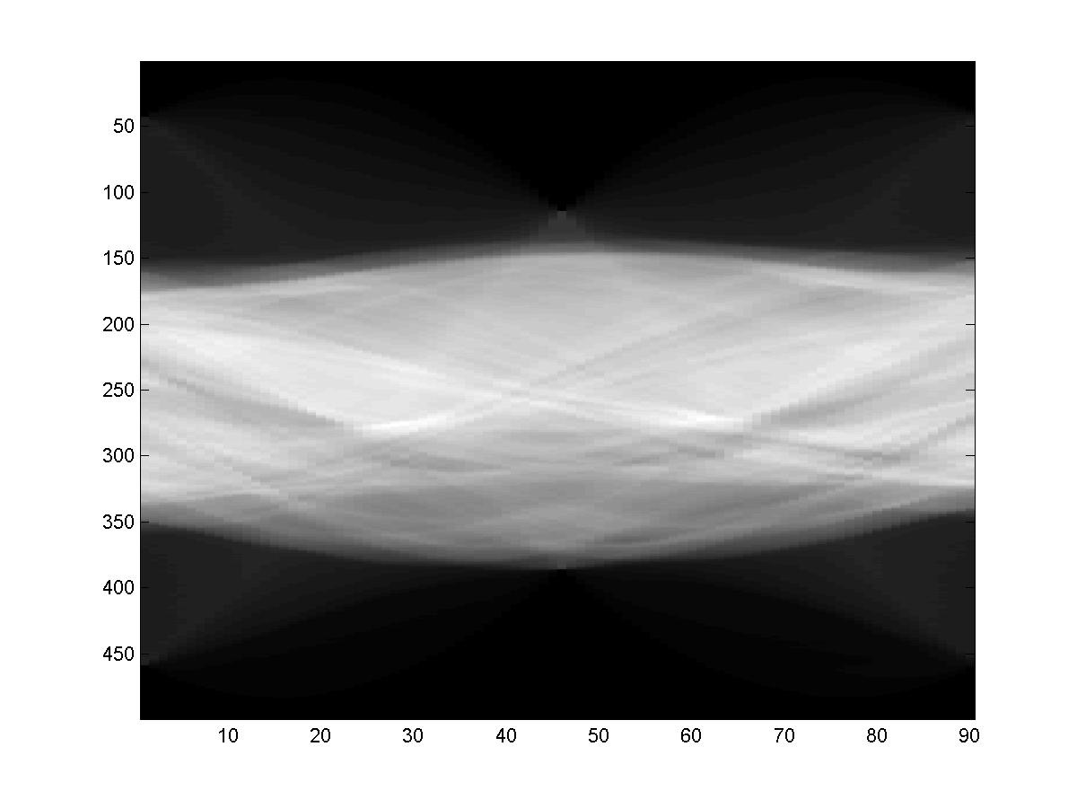
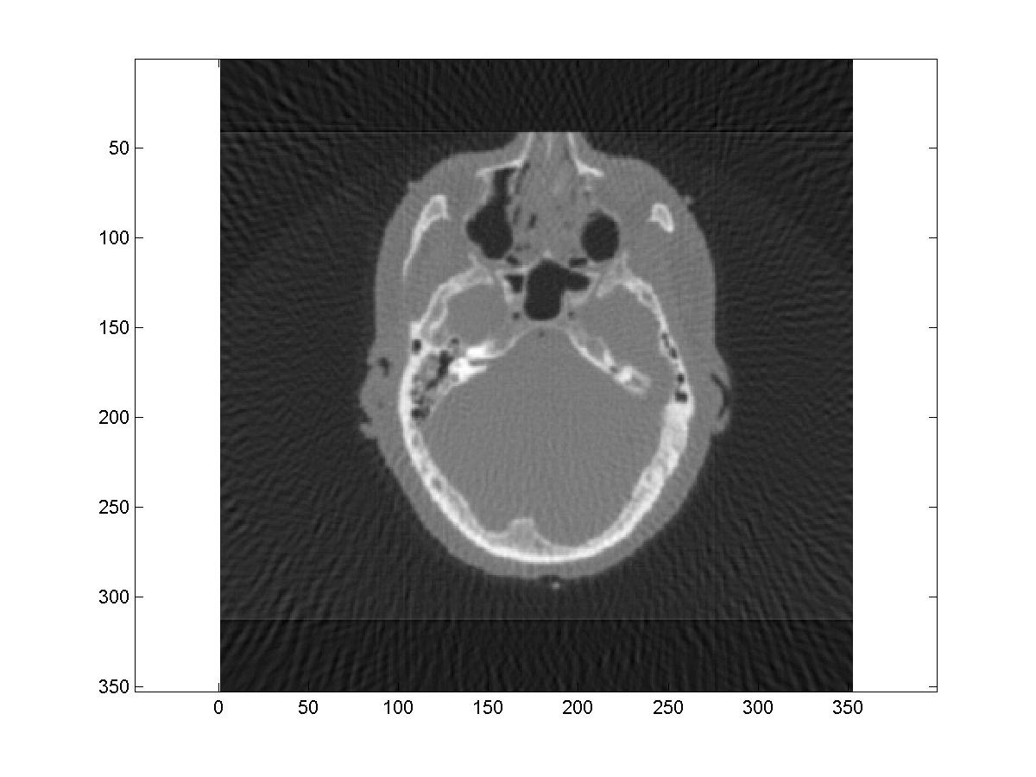
Computing to form images
A CT scanner measures this:
You need mathematical algorithms implemented on computers to get this:
You need mathematical algorithms implemented on computers to get this:
A light field microscope measures this:
Some imaging systems are inherently a combination of measurements and computation.
You need algorithms to solve inverse problems
to get the desired image.

Slide 6
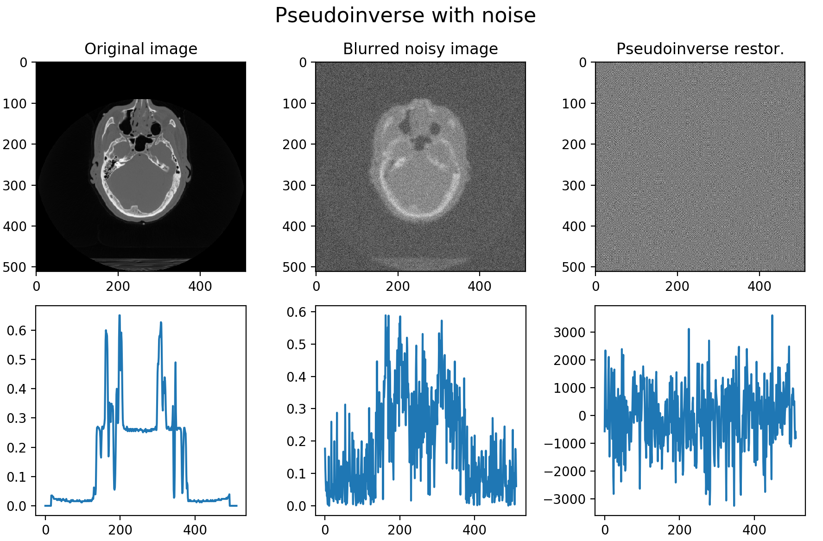
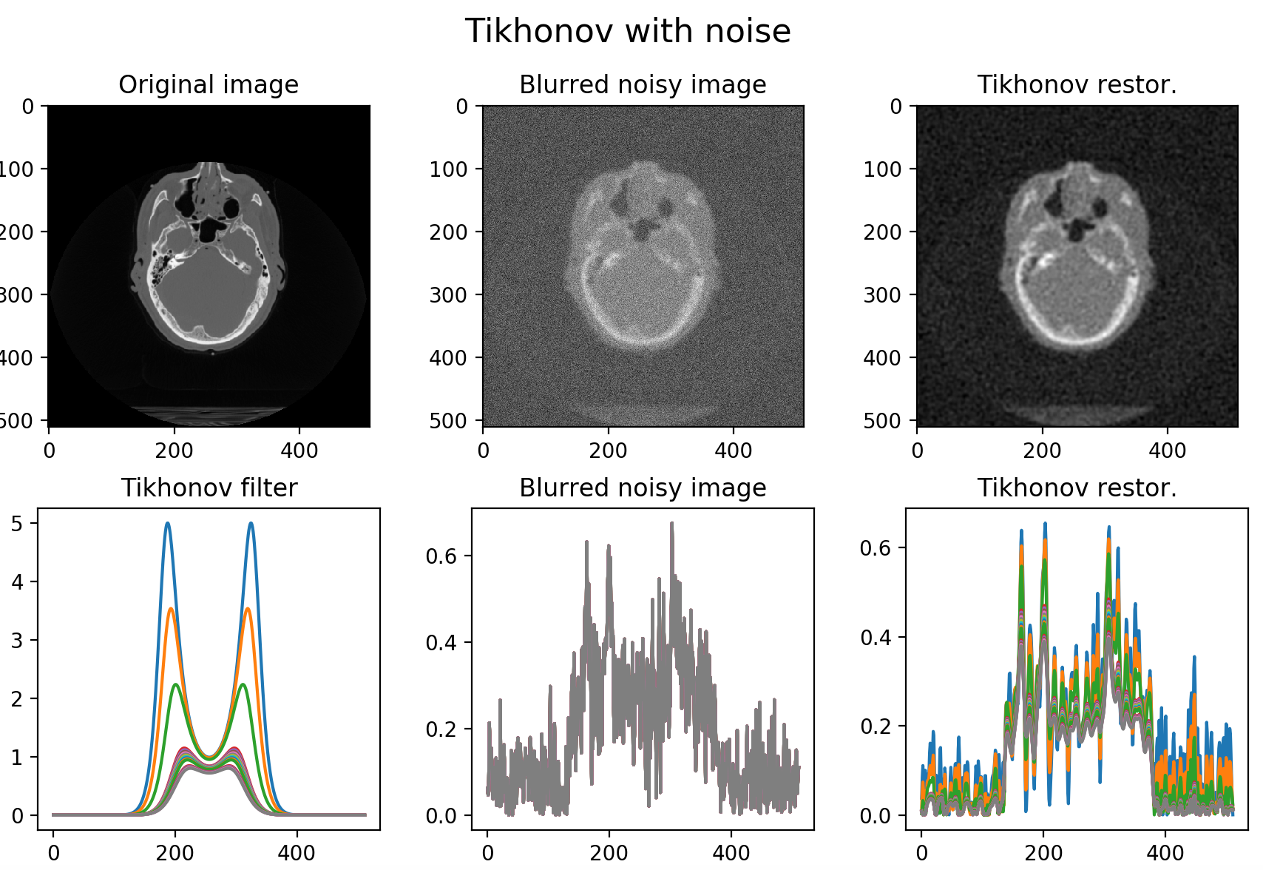
Computing to form images: deblurring/deconvolution
Naïve
Decon.
Better
Decon.

Slide 7
Setting up the
deconvolution problem

Slide 8
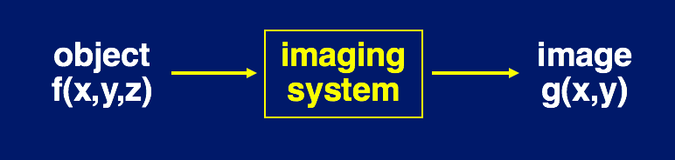
Imaging as a mapping between functions
An imaging system maps from 2D or 3D object function to a 2D or 3D image or image stack.
Notes:
Famous image from Rene Magritte. If it’s not a pipe, what is it? It’s an IMAGE of a pipe. Not the object itself but a representation of the object.
It’s made of paint and brushstrokes instead of wood and tobacco and subject to the distortion and interpretation of the artist’s perspective.
So we must remember that scientific images are, similarly, representations of their subjects. As representations they are distorted by the image capture device (telescope, microscope, camera, etc). The image of a point is not a point, it is a pattern of light called a point spread function (PSF).

Slide 9
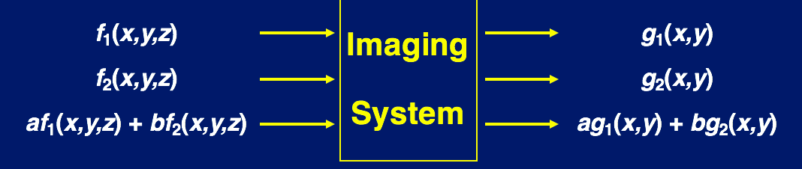
Most imaging systems are linear
Linearity exists if superimposition holds:
The image created from a weighted sum of inputs equals the same weighted sum of the corresponding individual images.
Notes:
Famous image from Rene Magritte. If it’s not a pipe, what is it? It’s an IMAGE of a pipe. Not the object itself but a representation of the object.
It’s made of paint and brushstrokes instead of wood and tobacco and subject to the distortion and interpretation of the artist’s perspective.
So we must remember that scientific images are, similarly, representations of their subjects. As representations they are distorted by the image capture device (telescope, microscope, camera, etc). The image of a point is not a point, it is a pattern of light called a point spread function (PSF).

Slide 10
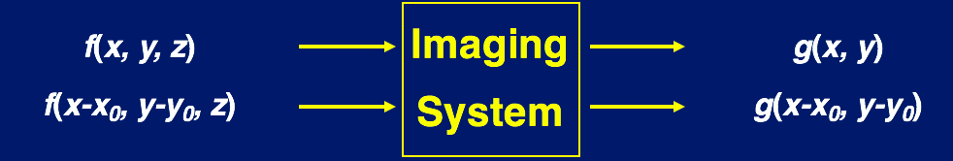
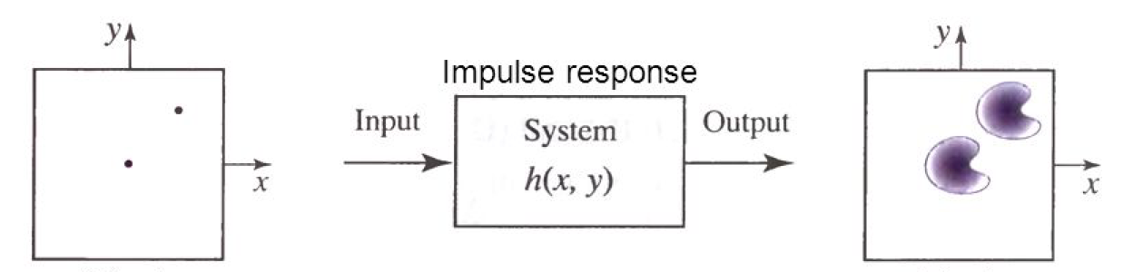
Most imaging systems are shift-invariant
Shifting the input just shifts the output
Notes:
Famous image from Rene Magritte. If it’s not a pipe, what is it? It’s an IMAGE of a pipe. Not the object itself but a representation of the object.
It’s made of paint and brushstrokes instead of wood and tobacco and subject to the distortion and interpretation of the artist’s perspective.
So we must remember that scientific images are, similarly, representations of their subjects. As representations they are distorted by the image capture device (telescope, microscope, camera, etc). The image of a point is not a point, it is a pattern of light called a point spread function (PSF).

Slide 11
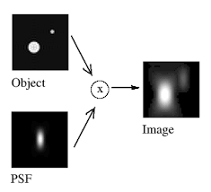
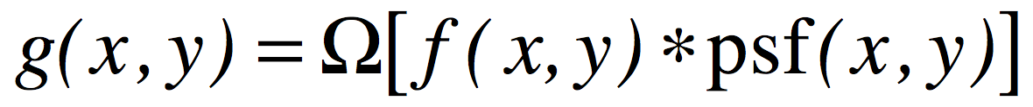
A linear, shift-invariant system can be characterized by a point spread function (PSF)
For a linear, shift-invariant system, the response of the system to an idealized point allows us to calculate the response to any general object!
Intensity
Notes:
If you were to draw a line across a PSF and plot the signal intensity as a function of distance, you would plot a representation of the Airy pattern.
The bright, central portion of the Airy pattern is called the Airy disk.
Measuring across the Airy disk at a point halfway to the maximum intensity gives the full width at half max (FWHM). The smaller your FWHM, the better the resolution of your imaging system.

Slide 12
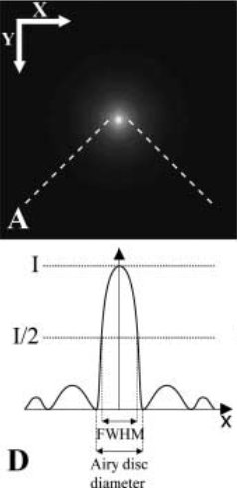
Typical microscopy PSF, aka Airy pattern
The better the spatial resolution of your system, the smaller the PSF/ Airy pattern.
Measurement of the full width at half maximum (FWHM) intensity is one way to determine resolution.
Intensity
Distance
Slide adapted from Christine Labno, UChicago
Image credit: Bolte and Corderlieres (2006) J. Microscopy v. 224 pt3, pg. 214
Notes:
If you were to draw a line across a PSF and plot the signal intensity as a function of distance, you would plot a representation of the Airy pattern.
The bright, central portion of the Airy pattern is called the Airy disk.
Measuring across the Airy disk at a point halfway to the maximum intensity gives the full width at half max (FWHM). The smaller your FWHM, the better the resolution of your imaging system.

Slide 13

From Point Spread Functions to Transfer Functions: Thinking in frequency space
Starring Goofy
Special guest star:
the Airy Fairy
Notes:
λ is the wavelength of light used for imaging, typically between 400 and 800nm
NA is the numerical aperture of the objective, typically between 0.1 and 1.45. NA is a measure of resolving power of the microscope and also a measure of light gathering capability.
For practical purposes, the higher the NA, the better the resolution and the greater the light gathering power.

Slide 14
Thinking in frequency space
Any well-behaved function can be expressed as a weighted sum over sinusoids.
We characterize each sinusoid by a frequency.
Higher frequency means wiggles faster.
Not surprisingly, a high-resolution imaging system is able to capture higher frequencies.
NOTE: We are NOT talking about different wavelengths of light here.
Notes:
λ is the wavelength of light used for imaging, typically between 400 and 800nm
NA is the numerical aperture of the objective, typically between 0.1 and 1.45. NA is a measure of resolving power of the microscope and also a measure of light gathering capability.
For practical purposes, the higher the NA, the better the resolution and the greater the light gathering power.

Slide 15
The Fourier transform
Taking a function apart into its constituent sinusoids is called a Fourier transform.
Notes:
λ is the wavelength of light used for imaging, typically between 400 and 800nm
NA is the numerical aperture of the objective, typically between 0.1 and 1.45. NA is a measure of resolving power of the microscope and also a measure of light gathering capability.
For practical purposes, the higher the NA, the better the resolution and the greater the light gathering power.

Slide 16
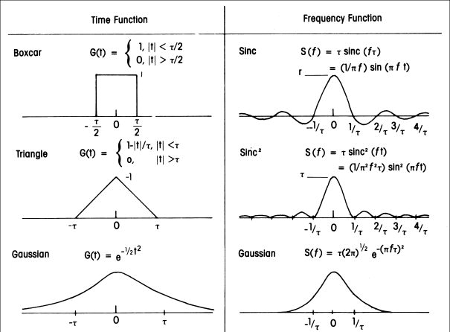
Fourier transform pairs
Notes:
λ is the wavelength of light used for imaging, typically between 400 and 800nm
NA is the numerical aperture of the objective, typically between 0.1 and 1.45. NA is a measure of resolving power of the microscope and also a measure of light gathering capability.
For practical purposes, the higher the NA, the better the resolution and the greater the light gathering power.

Slide 17
Wider in one domain means narrower in the other

Slide 18
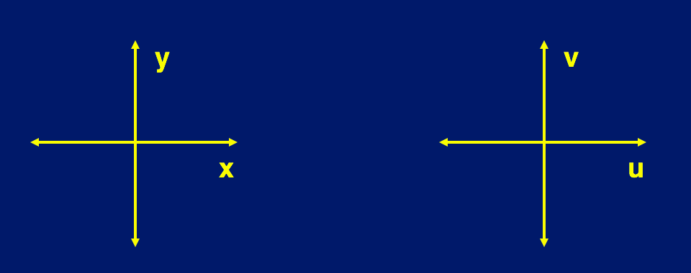
Thinking in 2D frequency space
Notes:
λ is the wavelength of light used for imaging, typically between 400 and 800nm
NA is the numerical aperture of the objective, typically between 0.1 and 1.45. NA is a measure of resolving power of the microscope and also a measure of light gathering capability.
For practical purposes, the higher the NA, the better the resolution and the greater the light gathering power.

Slide 19
Thinking in 2D frequency space
2d sinusoids
Their Fourier transforms
Notes:
λ is the wavelength of light used for imaging, typically between 400 and 800nm
NA is the numerical aperture of the objective, typically between 0.1 and 1.45. NA is a measure of resolving power of the microscope and also a measure of light gathering capability.
For practical purposes, the higher the NA, the better the resolution and the greater the light gathering power.

Slide 20
original
image
from http://www.cs.unm.edu/~brayer/vision/fourier.html

Slide 21
original
image
Fourier
transform
from http://www.cs.unm.edu/~brayer/vision/fourier.html

Slide 22
original
image
Suppress
high
horizontal
frequencies
Fourier
transform
from http://www.cs.unm.edu/~brayer/vision/fourier.html

Slide 23
original
image
x-blurred
image
Suppress
high
horizontal
frequencies
Fourier
transform
from http://www.cs.unm.edu/~brayer/vision/fourier.html

Slide 24
original
image

Slide 25
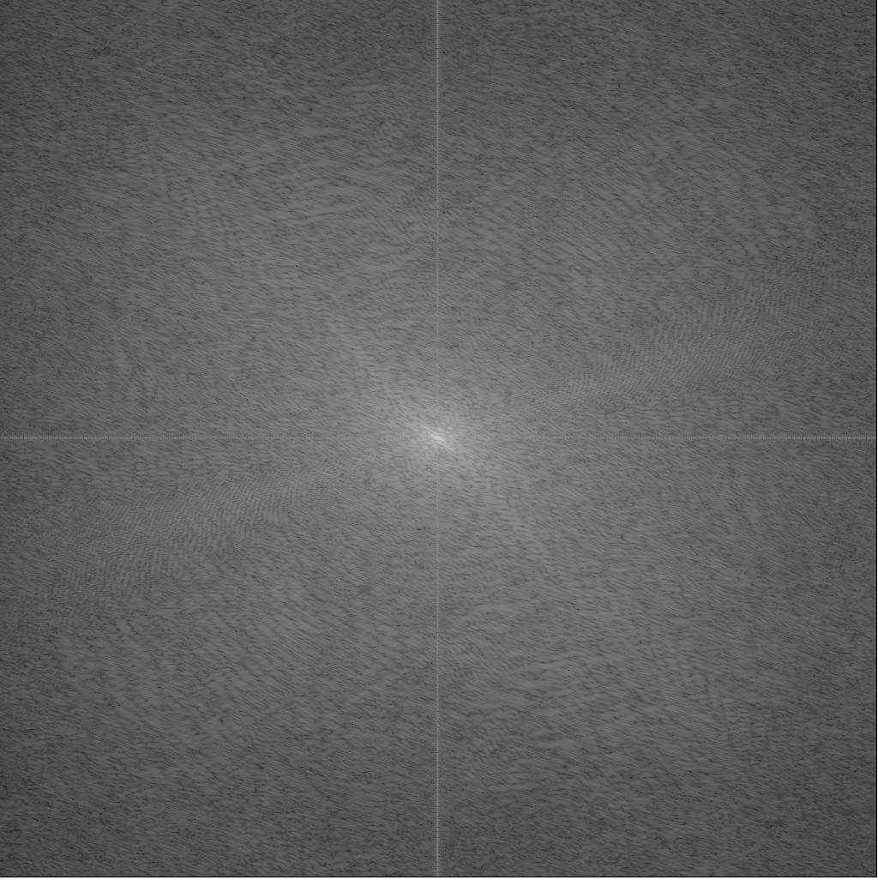
original
image
Fourier
transform

Slide 26
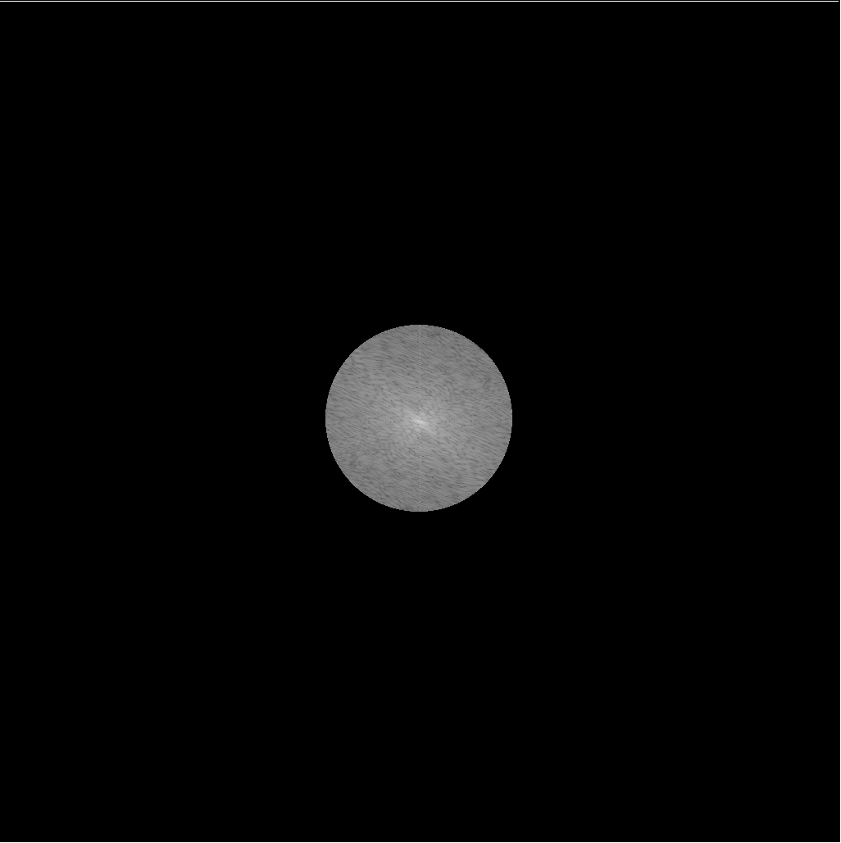
original
image
Fourier
transform
truncated
Fourier
transform

Slide 27
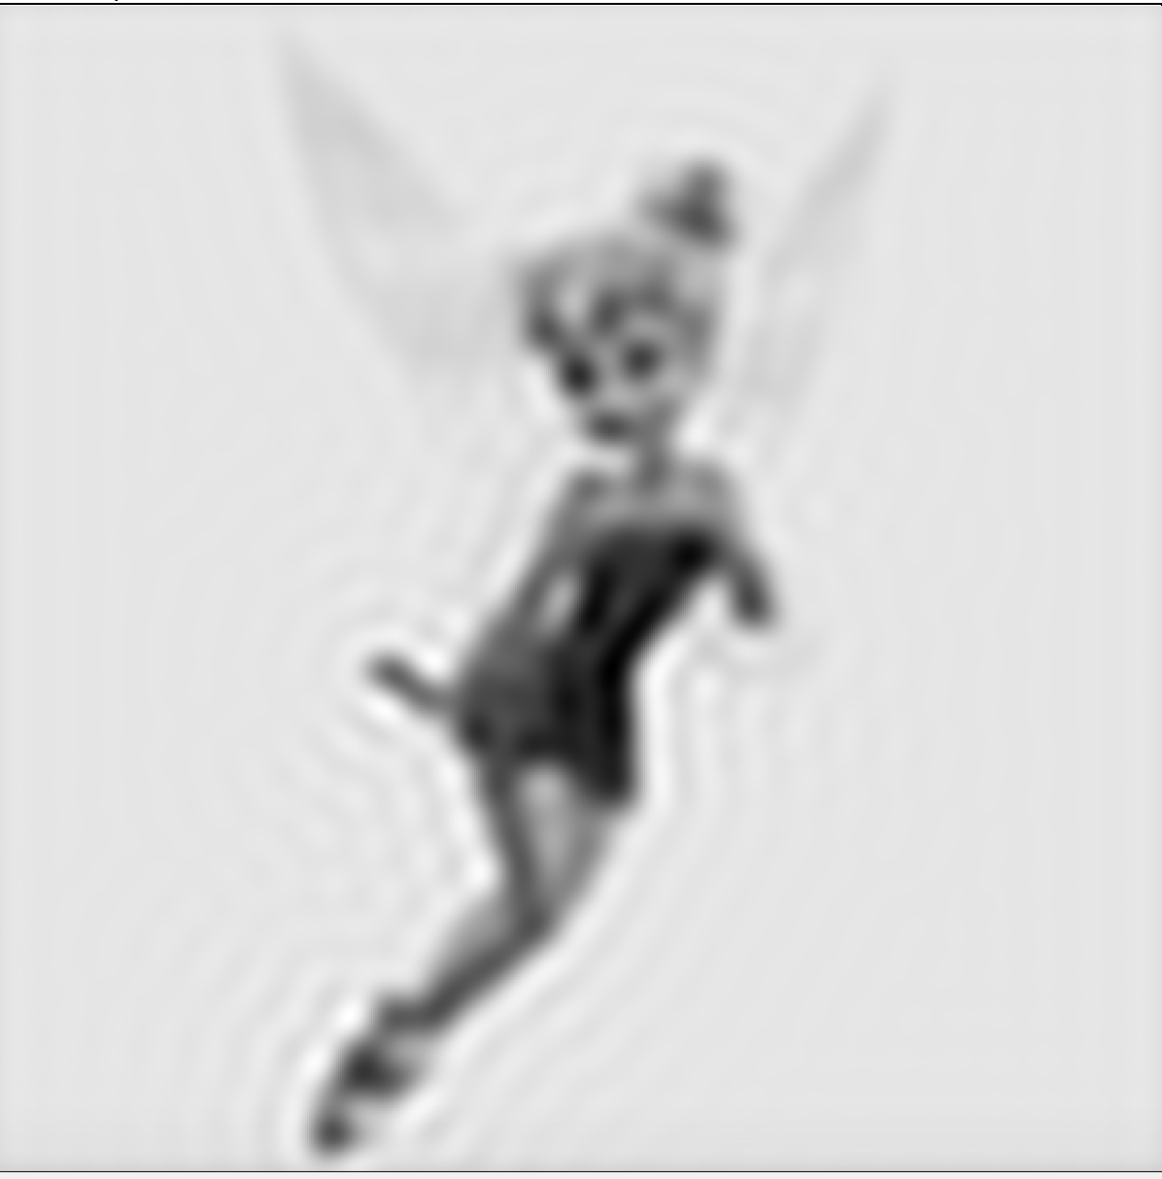
reconstructed
“inverse FT”
image
original
image
Fourier
transform
truncated
Fourier
transform

Slide 28
A lens as a Fourier optic
40x NA 1.35 oil
350ms exposure
40x NA 1.15 water
350ms exposure
40x NA 0.6 dry
350ms exposure
Input pattern
Lens decomposes spatial frequencies. Highest ones get truncated by lens aperture.
Output pattern
Notes:
Use the highest NA objective available. Increasing NA increases resolution / sharpness and light gathering ability. With higher NA generally comes some form of immersion, and that helps with light gathering ability as well.

Slide 29
Convolution-multiplication theorem
$$FT\left\{f\left(x\right)∗h(x)\right\}=F\left(u\right)H(u)$$
Multiplying in the Fourier domain by a function is the same as convolving in the spatial domain with the FT of that function.
Since a lens effectively multiplies the FT of the function by a circle, it is like convolving in spatial domain with the FT of a circle.
Notes:
Use the highest NA objective available. Increasing NA increases resolution / sharpness and light gathering ability. With higher NA generally comes some form of immersion, and that helps with light gathering ability as well.

Slide 30
What is the FT of a circle? A function whose square is the Airy pattern! (Square because we measure intensities not amplitudes and fluorescence is incoherent).
Notes:
Use the highest NA objective available. Increasing NA increases resolution / sharpness and light gathering ability. With higher NA generally comes some form of immersion, and that helps with light gathering ability as well.

Slide 31
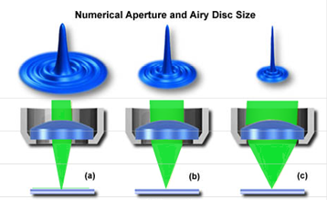
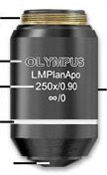
What Determines the Size of the Airy Disk?
Resolution (xy) = d = λ / 2NA
Resolution (z) = d = 2λ /NA²
Where λ is the wavelength of light used for imaging
NA is the numerical aperture of the objective
These equations were first published by Ernst Abbe in 1873
Insert tube lens here
NA = 0.2
NA = 0.8
NA = 1.3
Slide adapted from Christine Labno, UChicago
Image credit: Olympus Microscopy Resource Center
Notes:
λ is the wavelength of light used for imaging, typically between 400 and 800nm
NA is the numerical aperture of the objective, typically between 0.1 and 1.45. NA is a measure of resolving power of the microscope and also a measure of light gathering capability.
For practical purposes, the higher the NA, the better the resolution and the greater the light gathering power.

Slide 32
Higher Numerical Aperture = Brighter, Sharper Pictures
40x NA 1.15 water
350ms exposure
40x NA 1.35 oil
350ms exposure
Slide adapted from Christine Labno, UChicago
Notes:
Use the highest NA objective available. Increasing NA increases resolution / sharpness and light gathering ability. With higher NA generally comes some form of immersion, and that helps with light gathering ability as well.

Slide 33
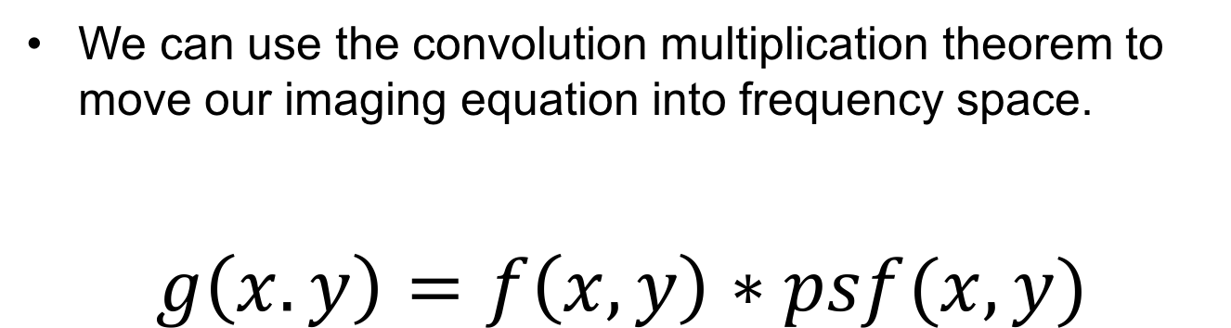
Optical transfer functions (OTF)
We can use the convolution multiplication theorem to move our imaging equation into frequency space.
$$g\left(x.y\right)=f\left(x,y\right)∗psf(x,y)$$
40x NA 1.35 oil
350ms exposure
40x NA 0.6 dry
350ms exposure
$$G(u,v)=F\left(u,v\right)OTF(u,v)$$
The Fourier transform of a PSF is called an optical transfer function OTF.
Notes:
Use the highest NA objective available. Increasing NA increases resolution / sharpness and light gathering ability. With higher NA generally comes some form of immersion, and that helps with light gathering ability as well.

Slide 34
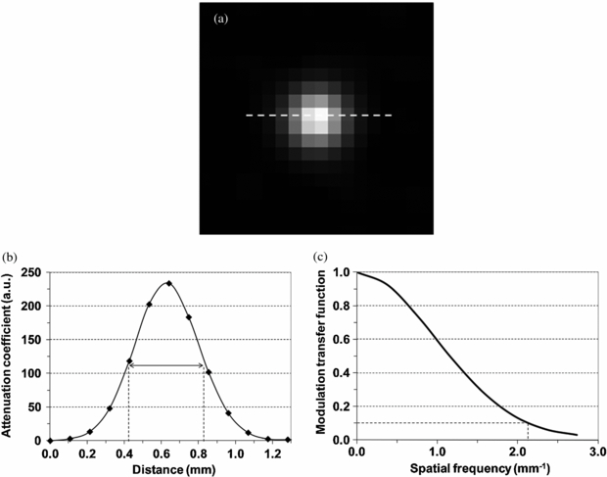
Properties of OTFs
Image of OTF
Cutoff frequency
PSF profile
OTF
profile
Notes:
Use confocal microscopy – the confocal pinhole only lets through the light from the Airy Disk, discarding light from the rest of the Airy pattern. This removes blur and reduces the size of the point spread function by approximately 30%. This reduction in PSF size gives better lateral (xy) and axial (z) resolution, allowing us to revise our Rayleigh criterion equation. On the downside, 90% of the light coming from the sample is outside the Airy disk, so your sample appears dimmer without compensation in the form of more excitation light or longer exposure time.

Slide 35
Properties of OTFs
Tells you how the amplitude of sinusoids of different frequencies are reduced when passed by the imaging system.
Notes:
Use confocal microscopy – the confocal pinhole only lets through the light from the Airy Disk, discarding light from the rest of the Airy pattern. This removes blur and reduces the size of the point spread function by approximately 30%. This reduction in PSF size gives better lateral (xy) and axial (z) resolution, allowing us to revise our Rayleigh criterion equation. On the downside, 90% of the light coming from the sample is outside the Airy disk, so your sample appears dimmer without compensation in the form of more excitation light or longer exposure time.

Slide 36
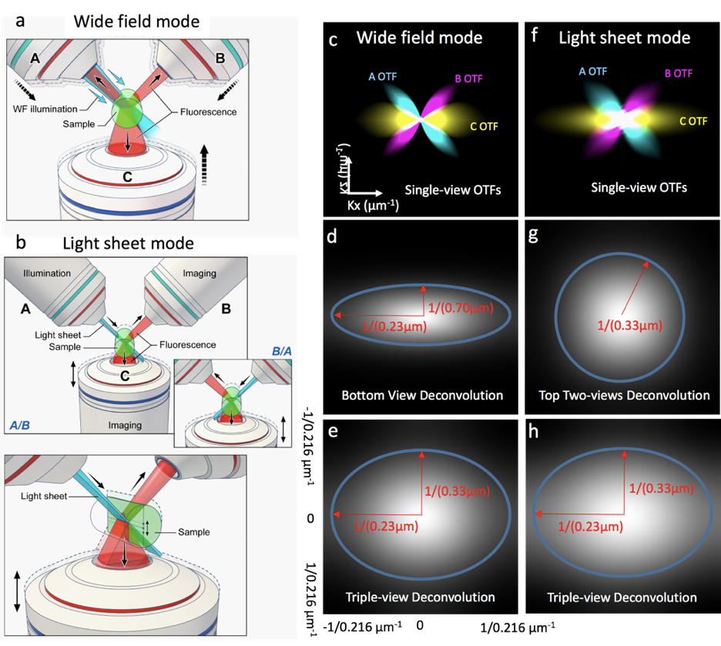
You want narrow PSFs and wide OTFs
40x NA 0.6 dry
350ms exposure
Notes:
Use the highest NA objective available. Increasing NA increases resolution / sharpness and light gathering ability. With higher NA generally comes some form of immersion, and that helps with light gathering ability as well.

Slide 37
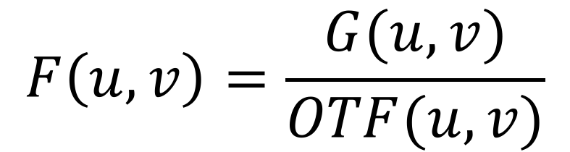
Can’t we solve the OTF equation?
$$G(u,v)=F\left(u,v\right)OTF(u,v)$$
Degraded image
Desired image
FT of PSF
$$F\left(u,v\right)=\frac{G(u,v)}{OTF(u,v)}$$
?

Slide 38
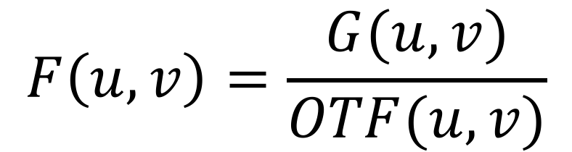
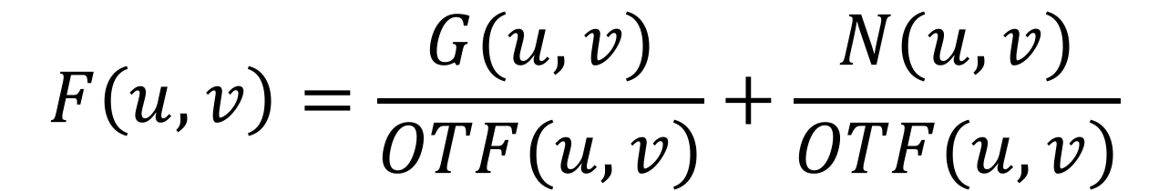
Can’t we solve the OTF equation?
$$F\left(u,v\right)=\frac{G(u,v)}{OTF(u,v)}$$
What if this is 0?
$$F\left(u,v\right)=\frac{G(u,v)}{OTF(u,v)}+\frac{N(u,v)}{OTF(u,v)}$$
Noise gets amplified when OTF is small

Slide 39
Properties of OTFs
Image of OTF
Cutoff frequency
PSF profile
OTF
profile
Notes:
Use confocal microscopy – the confocal pinhole only lets through the light from the Airy Disk, discarding light from the rest of the Airy pattern. This removes blur and reduces the size of the point spread function by approximately 30%. This reduction in PSF size gives better lateral (xy) and axial (z) resolution, allowing us to revise our Rayleigh criterion equation. On the downside, 90% of the light coming from the sample is outside the Airy disk, so your sample appears dimmer without compensation in the form of more excitation light or longer exposure time.

Slide 40
How to deal with these challenges?
Pseudoinverse: only divide by the OTF when it is not zero. Otherwise set to zero.
Tikhonov regularization: Add a constant to the denominator so you never divide by zero or by a small number.
Gradient-norm regularization: Further modification to the denominator.
All of these are implicitly imposing crude forms of prior information.
Iterative methods with sophisticated priors.
Deep learning with learned priors.
Notes:
Use confocal microscopy – the confocal pinhole only lets through the light from the Airy Disk, discarding light from the rest of the Airy pattern. This removes blur and reduces the size of the point spread function by approximately 30%. This reduction in PSF size gives better lateral (xy) and axial (z) resolution, allowing us to revise our Rayleigh criterion equation. On the downside, 90% of the light coming from the sample is outside the Airy disk, so your sample appears dimmer without compensation in the form of more excitation light or longer exposure time.

Slide 41
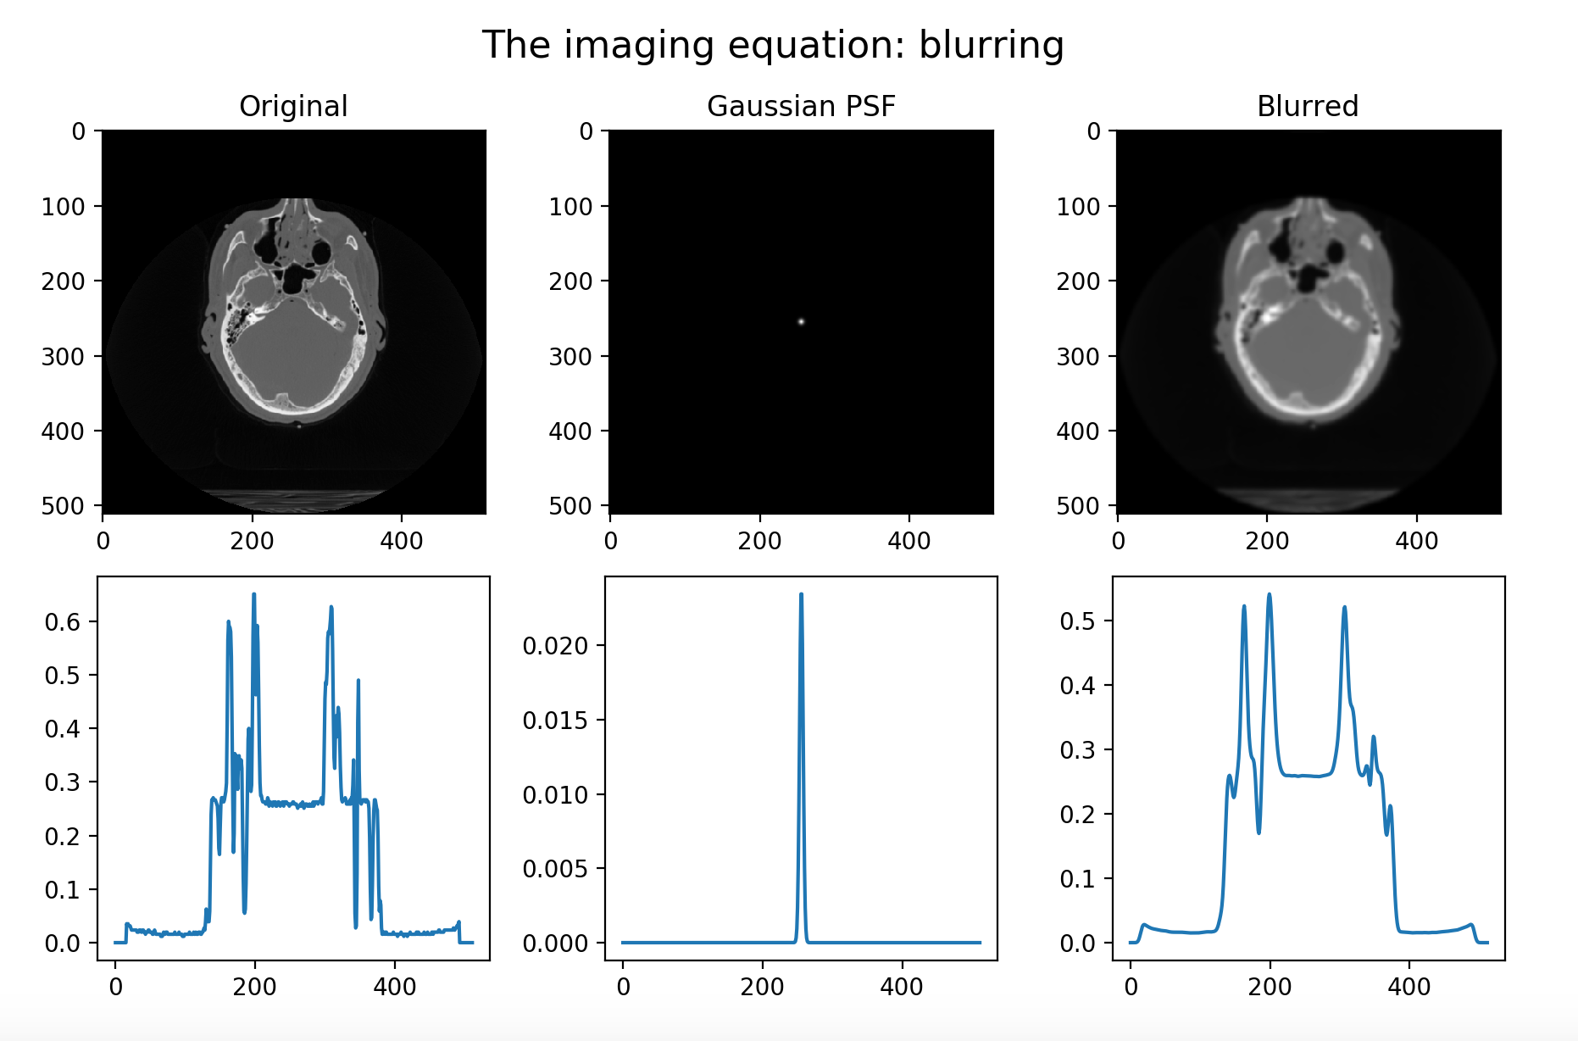

Slide 42
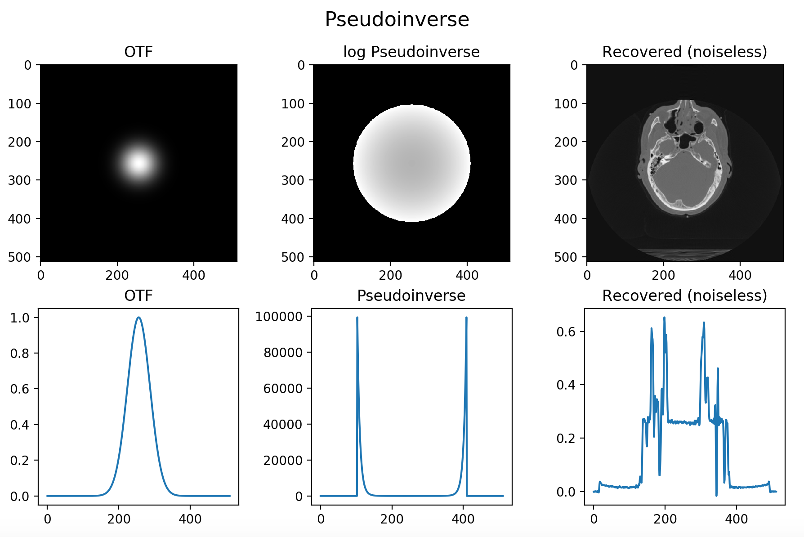
Pseudoinverse: only divide by the OTF when it is not zero. Otherwise set to zero. Works well for noiseless data.

Slide 43
Pseudoinverse: FAILS BADLY FOR NOISY DATA.

Slide 44
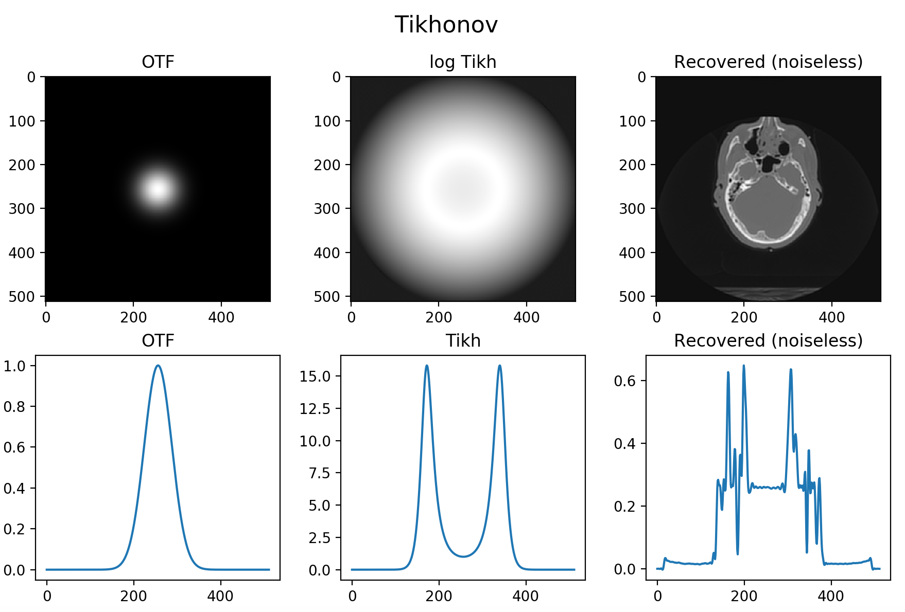
Tikhonov regularization: Add a constant to the denominator so you never divide by zero or by a small number.

Slide 45
Tikhonov: Better behaved for noisy data. Can control regularization strength.

Slide 46
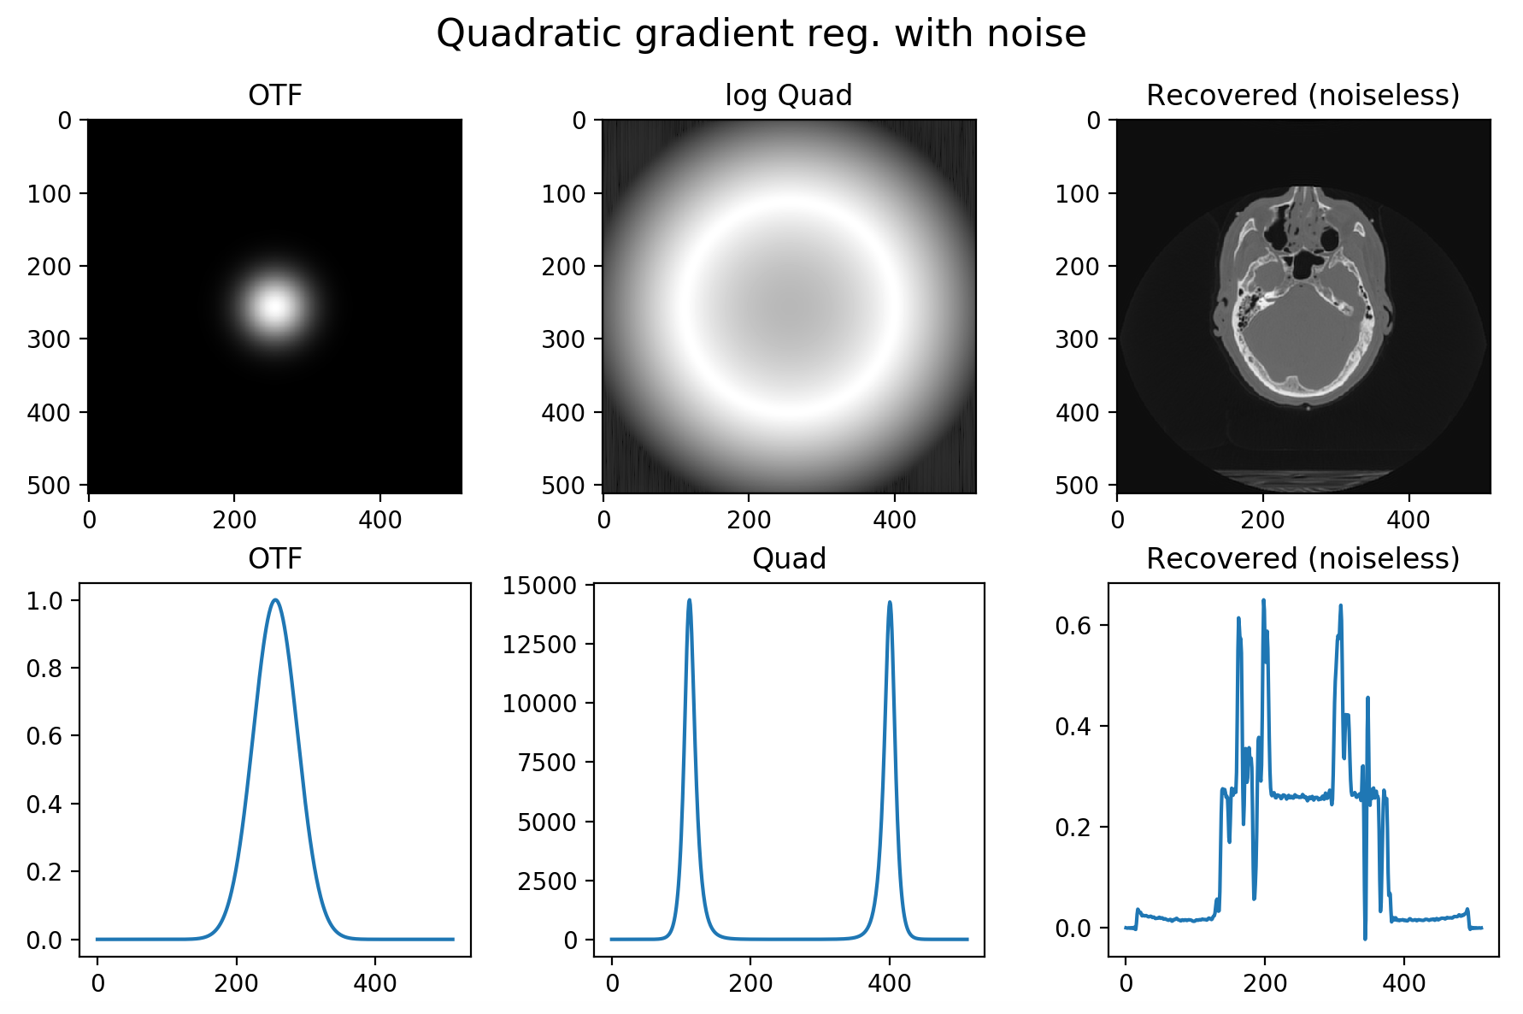
Gradient-norm regularization: Further modification to the denominator. (Further suppresses high frequencies.)

Slide 47
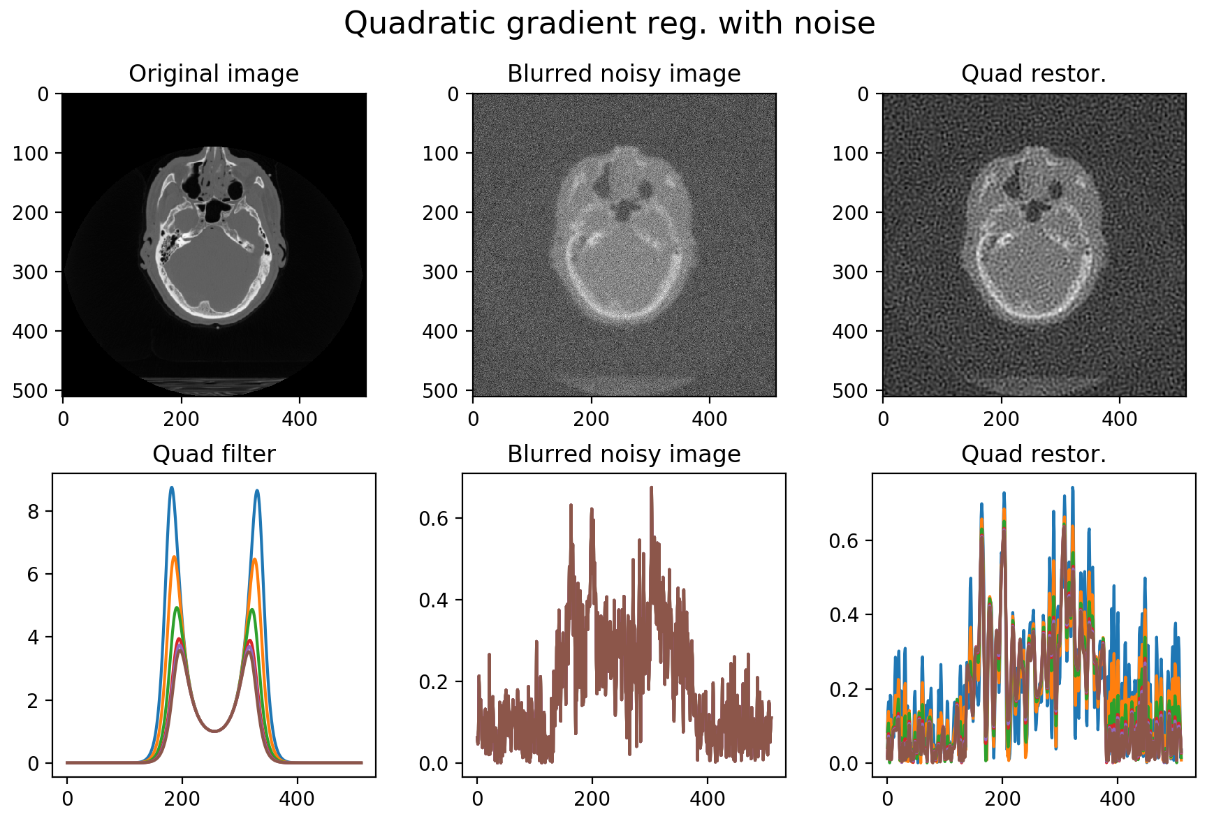
Gradient-norm regularization: Further modification to the denominator. (Further suppresses high frequencies.)

Slide 48
Iterative solutions to inverse problems
A deterministic model mapping object to data
Data
System
Object
Objective function:
Find f > 0 maximizing
Algorithm to find maximum of objective function
f^{(new)} =f ^{(old)} +U(f^{(old)})
A noise model for the data
Prior assumptions about object:
f has small roughness R(f)

Slide 49
In plain English
Our goal is to reconstruct an image that is a map of some object property (like fluorophore concentration).
That reconstructed image should agree---in a statistical sense---with the measured data when we act on it with a mathematical model of the imaging system.
That reconstructed image should reflect any prior knowledge or assumptions we wish to impose, either as hard constraints (no negatives allowed!) or soft constraints (encourage smoothness)

Slide 50
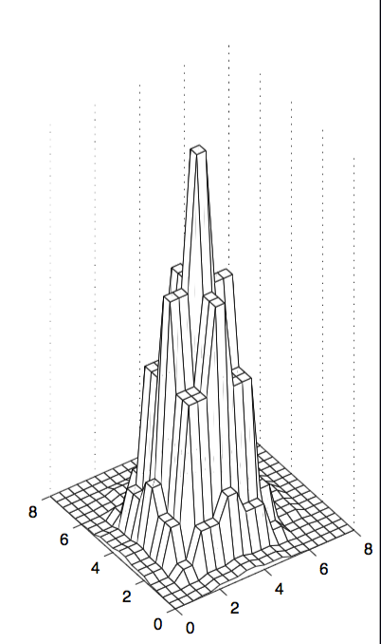
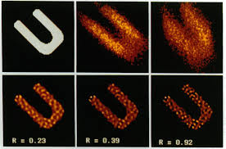
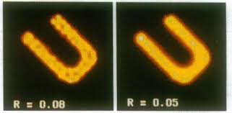
Prior assumptions about object:
f has small roughness R(f)
Prior assumptions
In general, if you try to find the object that agrees well with noisy data, you will get a noisy object.
We can do better by attempting to enforce some prior knowledge or assumptions about the object.
Non negativity
Smoothness
Sparseness
Pixel values all non-negative
Underlying object more likely to be smooth than rough
Limited non-zero pixels in image or its gradient

Slide 51
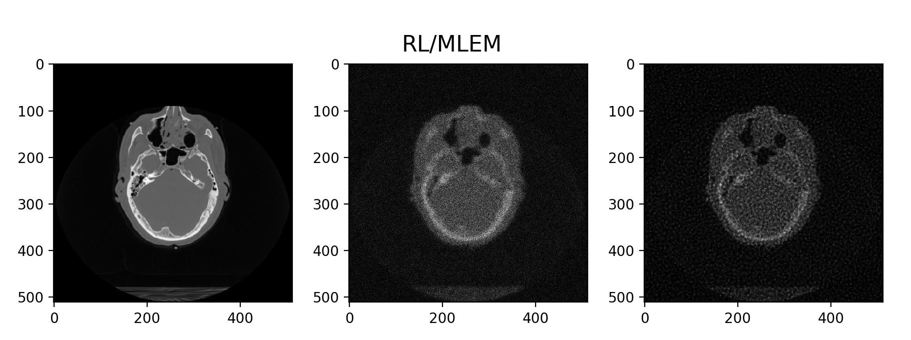

Slide 52
Classical methods vs deep learning
Classical methods generally work well and efficiently when
You have a good and accurate model of the PSF
The system is indeed shift invariant in all dimensions, which allows you to use efficient FFTS
The data quality is high enough that enforcing relatively simplistic priors provides good regularization
Deep learning
Unknown system model
Lack of shift invariance
Very low quality data requiring more subtle learned priors
Deep learning challenges
You need appropriate pairs of of high and low quality images to train on
If you do have knowledge of the system PSF, how do you incorporate it?
Notes:
Use confocal microscopy – the confocal pinhole only lets through the light from the Airy Disk, discarding light from the rest of the Airy pattern. This removes blur and reduces the size of the point spread function by approximately 30%. This reduction in PSF size gives better lateral (xy) and axial (z) resolution, allowing us to revise our Rayleigh criterion equation. On the downside, 90% of the light coming from the sample is outside the Airy disk, so your sample appears dimmer without compensation in the form of more excitation light or longer exposure time.

